Slide 1
ProgTeam Week 2
Solutions Presentation
Binary Search

Slide 2
A - Bootstrap Number
The function x^{x} is monotonically increasing for x > 1
This means we can use binary search for its inverse
For a given point m, if m^{m} > n, we know m is too big
Otherwise m is too small

Slide 3
B - Small Schedule
To binary search the answer, try to solve “Can we finish in T minutes”:
Greedily add as many of the long intervals onto each machine as possible
We can always fill in the leftovers with the short intervals, since they have length 1
Alternate approach without binary search exists
Pitfalls: Look out for overflow

Slide 4
C - Free Weights
Decision problem: can we organize all weights if the heaviest weight we can lift is M?
Observation: we’ll always be able to pair together weights that are less than M
Since we can’t move the others relative to each other, we can check if they’re in pairs

Slide 5
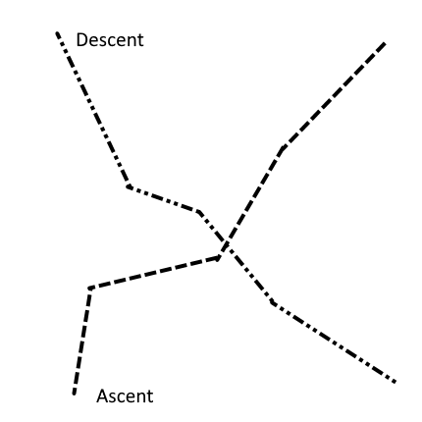
D - Traveling Monk
Given two piecewise monotonic linear functions, find where they intersect
Observation: once two paths cross, they never meet again
Ascending path will always be further up than descending afterwards

Slide 6
E - Kayaking Trip
If we can achieve a minimum velocity of X, we can definitely achieve a minimum velocity of (X + 1)
Just use the same set-up as X!
To check if we can achieve a minimum velocity of X, start with slowest kayaks
Greedily add beginners as soon as possible
We need to use them anyway-might as well with the weakest kayaks
Make sure velocity stays above X

Slide 7
F - ICPC Camp
Clearly the maximum difference is monotonic
Can we check if we can achieve a difference of D?
Pair the most difficult questions in one category with the highest possible difficulty in the other
Implementation is n log² n which can be reduced to n log n
But either one requires some clever data structures to find the highest possible difficulty in other category

